Slide 1
SYNCOPE AND FAINTING
Problem solving module II

Slide 2
Syncope-presyncope or Faint
Syncope : Transient episodic loss of consciousness with loss of postural tone due to cerebral or brain stem hypo perfusion.
blackout=wide term.
Pre syncope or faint ? It is lightheadedness or pre monitory symptoms before syncope (patient is going to have syncope).

Slide 3

In This Lecture (Syncope And Fainting)
Consciousness and it’s elements.
Mechanism of consciousness, factors affecting it? clinical effect ?
Basic anatomy of nervous system.
Common clinical causes of syncope ? Draw concept map for each cause if possible in group discussion session.
Approach and clinical scenario to differentiate between different causes? Behave like a doctor?
1-History and examination.
*From good history: decide type of pt. complain , causes then ask good questions for confirming or rule out certain cause (Crossing words ,It is an Art ,art, art, art* you can get it by exercise).
2-Investigations help to rule out or confirm different causes?
3-Treatment of common causes. (Later on)

Slide 4
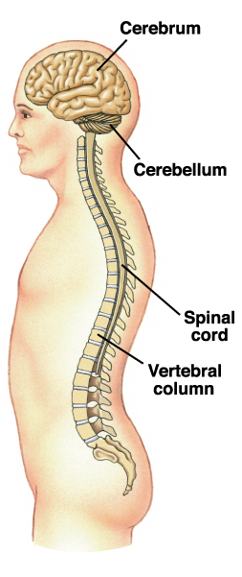
ORGANIZATION OF THE NERVOUS SYSTEM
2 big initial divisions:
Central Nervous System
The brain + the spinal cord
The center of integration and control
Peripheral Nervous System
The nervous system outside of the brain and spinal cord
Consists of:
31 Spinal nerves
Carry info to and from the spinal cord
12 Cranial nerves
Carry info to and from the brain

Slide 5
AUTONOMIC NERVOUS SYSTEM
Can be divided into:
Sympathetic Nervous System
“Fight or Flight”
Parasympathetic Nervous System
“Rest and Digest”
These 2 systems are antagonistic.
Typically, we balance these 2 to keep ourselves in a state of dynamic balance.
We’ll go further into the difference between these 2 later on !

Slide 6
Definitions
Consciousness? Ability to maintain contact to the environment(time ,person, and place? how?
Continuous bilateral signals from mid pons to both thalami
and cerebral cortices(cortex) see figure of CNS(N.S anatomy in simple way? See figures
*(N/P unilateral lesion or below mid pons lesion----no LOC )
Dizziness ? Non specific and wide term include pre -syncope , vertigo , balance disturbance , epilepsy (you need good history to differentiate between them).
Sleep??? Group discussion.

Slide 7
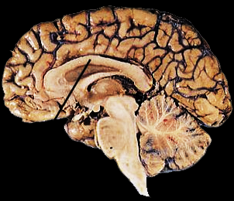

Slide 8
Syncope and LOC –pathophysiology-concept
What are the elements of consciousness?
1-Contents ? function of cortex----lesion/disease ----dementia
2-Level (wakefulness and awareness?-function of reticular activating system (RAS ) in mid pons to the cortex ---lesion----disturb consciousness ( syncope , confusion , delirium , and sever one is coma).
Factors we needs to maintain our consciousness?
Blood (cardiac pump, volume, HB) , sugar ,
harmonic neural electrical signal
Can you mention some causes that lead to transient or episodic LOC due affection of these factors ?
If it is due to affection of cerebral perfusion CP------syncope
If CP is reduced ----pre syncope symptom then syncope if continue.
Syncope affect 20% of population at some time and 5% of hospital admission.

Slide 9

THINK LIKE A DOCTOR TO HELP OTHERS

Slide 10

ETIOLOGY
Syncope: Transient episodic loss of consciousness with loss of postural tone usually due to global cerebral or brain stem hypo perfusion.
1-Cardiovascualr disease .
arrhythmias (Tachy or brady as in semester 2) .
left ventricular dysfunction .
aortic stenosis .
obstructive cardiomyopathy.
2-Neuro-cardiogenic causes(abnormal autonomic reflex)
Vasovagal syncope (simple faint) =8-41% of cases.
situational syncope ( cough or micturition syncope)
carotid sinus syncope.
3- Orhostatic hypotension.=bp drop on standing from sitting or flat position
Hypovolemia (loss of fluid or blood) .
autonomic dysfunction .
drugs (diuretics and antihypertensive----).
varicose veins and prolonged bed rest.
4-Neurological and psychiatric disease .
Transient ischemic attacks( bilateral and basilar artery )
Panic attacks.
Hyperventilation.
5-Unknown.

Slide 11
Differential Diagnosis = Syncope Like Hypoglycemia , Seizure , Loss Of Balance , Anemia (After Exertion).
Clinical types and scenarios of presentations? How we can solve the problem and reach diagnosis-group discussion.
--History(pt. or witness) : listen and ask about premonitory S. and triggers ,unconscious period and recovery period these will give you hint about diagnosis.
Ask about recurrence? previous health ? diet? Drugs? Any fluid loss (diarrhea) or blood loss(bleeding)? Menstruation? stress related? family history-----e ct
--Examination ;check the patient for relevant signs.
--Investigate to confirm or rule out a cause.
--Treatment.

Slide 12
APROACH
premonitory symptom Before LOC
LOC period-during
After LOC

Slide 13
Clinical types of syncope
Case1 : A 32 years old Iraqi man with recurrent attacks of LOC with full recovery, not related to position ;it is brief for less than one minute.
Is it syncope? Type ? Cause? Discussion---
Initial Qs and additional information? Q&A
*Is it preceded by feeling of palpitation as pt. describes (pt.: yes) ; * any involuntary movement during falling (pt.: no). *you had any history of blood loss or fluid loss(Pt.; no),* any drug intake or *missing meals(pt: no)
Initial Diagnosis?
Cardiac syncope
Neural mediated –Vasovagal or hypotension syncope
Psychogenic S.
Neurological disease or seizure
Hypoglycemia .

Slide 14
It is? --------cardiac ? Then you should think about probable cardiac cause (see etiology of cardiac syncope)
So you need Subsequent Qs to ask again to rule out or confirm certain causes, This is the aim of module( think about causes of arrhythmia)
Ex¹: If there is history of fluid loss , anorexia , thyroid problem the cause will be electrolyte disturbance most likely hypokalemia causing arrhythmia ? Stress related syncope (panic)?missing meals in hypoglycemia ? All negatives.
Ex²: Or history of deafness/ family history of Arrhythmias or sudden death( patient answer : yes yes ?Make diagnosis at this stage???? A: congenital prolonged QT syndrome ?
Then think about causes of prolonged QT syndrome?
Questions you should ask? Same as above additional information
acquired causes as certain drugs(antipsychotic ,anti diabetes drugs) ,or electrolytes disturbance(magnesium and K+); low K+ as in thyroid problem , diarrhea ,and anorexia
Inherited as in our cause ? Ask History of deafness/ family history of Arrhythmias or sudden death( patient : yes ,yes)

Slide 15
How you investigate this case
***To confirm the main problem 1st ?
Ex: Cardiac syncope ?
A/ ECG , ambulatory ECG to confirm arrhythmia
***Then search the cause or rule out some(see etiology)
A/ ECG to see features of prolonged QT interval & echocardiogram to exclude structural heart lesions in Ex.2.(prolonged QT syndrome) and Serum K+ level in Ex.1(case of fluid loss)
In certain cases you should perform Blood sugar to rule out hypoglycemia ?? HB , blood picture to rule out anemia and EEG to rule out seizure. NEXT SLIDES.
Confirmatory test in congenital prolonged QT syndrome?
Genetic test –Autosomal or recessive Inheritance(semester 2) .

Slide 16
Neuro-cardiac Syncope-Vasovagal
Case 2 : A 20 years old medical student in his 2nd year class ;while he standing in the clinical session watching his 1st anatomy lab. , felt down on the ground suddenly ?
Good Questions you should ask? Same in C. syncope.
You have to ask about Premonitory symptom and triggers, blackout period , and recovery.
Additional information were asking about out any H/O blood loss* ,drug intake* or missing meals* ,any involuntary movement* and Family history*? (Group discussion)
A/ He was in standing for long time* , emotional factors (emotionless standing) ,then He developed nausea , pallor and sweating then fell down with slow recovery ,his pulse was slow in black out period .
Questions ? No blood or fluid loss , no drug intake ,normal diet ,no involuntary movement and family history was negative.
Is it syncope? Type ? Cause? A/ yes, vasovagal S.??
How you investigate if the case is recurs? A/ ?

Slide 17
Mechanism Bezold-jarisch Reflex (Mechanism of VVS)
Mechanism of Vasovagal S. ? Decrease venous return to the heart(prolonged standing) -sympathetic stimulation as compensatory mechanism –abnormal contraction of under filled V. lead to tachycardia then, there is stimulation of cardiac mechanoreceptor lead to stimulation of parasympathetic mediated via Vagus nerve result in hypotension (vasodepressor response) and bradycardia (cardiac inhibitory response) making diagnosis of VVS.(in physiology)
This is called Bezold-Jarisch reflex.

Slide 18
Vasovagal Syncope =VVS
Seen in all age , commonest type of S. .
Triggers: prolonged standing specially emotionless state , pain , sight of blood ,medical instrumentations and excess of heat exposure.
Position ; standing .
Premonitory S. –sweating ,pallor , dizziness , blurred vision , tachycardia (sympathetic stim. 1st ).
Unconscious period : brief LOC with drop of BP , bradycardia (parasympathetic effect).
Recovery; rapid when assuming horizontal position with headache.
Investigations? Head tilt test----provocative test for Vasovagal response ;pt connected to ECG and BP tool the head of table elevated 60-70 degree for 45 min.
HTT indicated also in border line case of orthostatic hypotension
Treatment ? Avoid triggers, excess salt, drugs some times ?

Slide 19
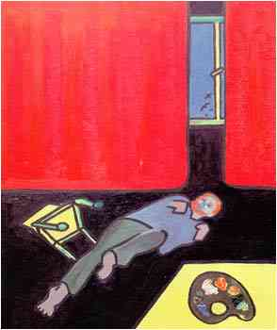
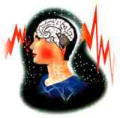
DD –syncope like --important
Anemia ; loss of conscious seen in exertion ,see pallor in examination and HB is low in blood test.
Hypoglycemia : missing meal , poor diet intake , over dose of insulin in DM patient , slowly evolving (pallor, sweating , tachycardia for longer period than that in VVS. Blood sugar is low , response to sweets or hypertonic fluid infusion.
Is it syncope? A/ We call it blackout(wide term) not syncope?
Seizure ? abnormal excessive hyper neuronal discharge

Slide 20
Case 3
A 34 years old man presented to emergency with recurrent loss of consciousness at his work and brought by his friend to hospital who mentioned that all of sudden, he collapsed on the ground with spasm all over and abnormal movement sound and tongue bite ;the symptoms subsided within 2-3 minutes and his cons recovered after 60 minutes ;he was oriented but with sever headache and minimal deficit on right side.
Questions you ask as before? blood loss ,drug intake, missing meal, stress related---all negative
Is it syncope ? What is most likely diagnosis?
Diagnosis ? Which one is true?
1-EEG, CT or/ and MRI
2-ECG , Blood sugar , blood film

Slide 21
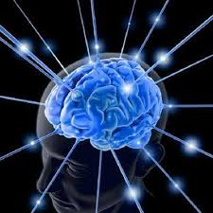
Other types of syncope
Situational(cough , micturition S.)
Carotid Sinus Syncope
Orthostatic Hypotension.=sudden drop of BP on standing from static posture.
(cause many like drug ,fluid or blood loss ,Varicose vein(polling of blood in legs up on standing) and autonomic dysfunction as in DM)
Neurological Diseases Like TIA =Transient Ischemic Attack or stroke.

Slide 22
Dear students
Always remember
** Things you read ;you forget
**Things you see ;you remember
**Things you do ; never forget

